Slide 1

Department of Computer Science and Engineering
IOT BASED ATTENDANCE SYSTEM USING BLOCKCHAIN
Date: 19 April 2021
Gottimukkula Manasa : 17wh1a05b6
Muthyala Srilatha : 17wh1a05a4
Lanka Sowmya : 18wh5a0513
Internal Guide: Mr. Bapiraju Mudunuri
Designation : Assistant Professor

Slide 2

Abstract
Why Should I Study this course?
Attendance monitoring is currently designed with android or web based applications. However the intention of this design is to provide a block chain based app that can be downloaded and used by the organization with no third party control to meddle with the data. On a blockchain based system, no administrator permission is allowed to editing or deleting data. Someone who inserts an information record on the blockchain will not be able to deny that he is doing the activity. There is an update option to modify attendance when it’s needed. However the modifications are recorded and tracked, just in case it’s a fraudulent activity. Attendance is captured using IOT automatically and is entered into the blockchain which makes the data tamper-proof, secure and robust. The privacy of it’s users is preserved because the user ids are generated by trusted third party. This data is available for government for Scholarship and other related decision making. The success of this app, will ensure that many more parents and organizations will be motivated to use this common platform.
Examples
BVRIT HYDERABAD College of Engineering for Women

Slide 3
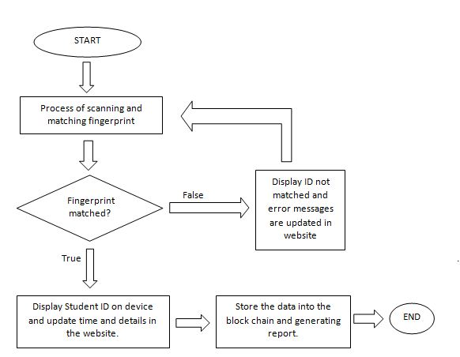
Flow Diagram
Why Should I Study this course?
Examples
BVRIT HYDERABAD College of Engineering for Women

Slide 4
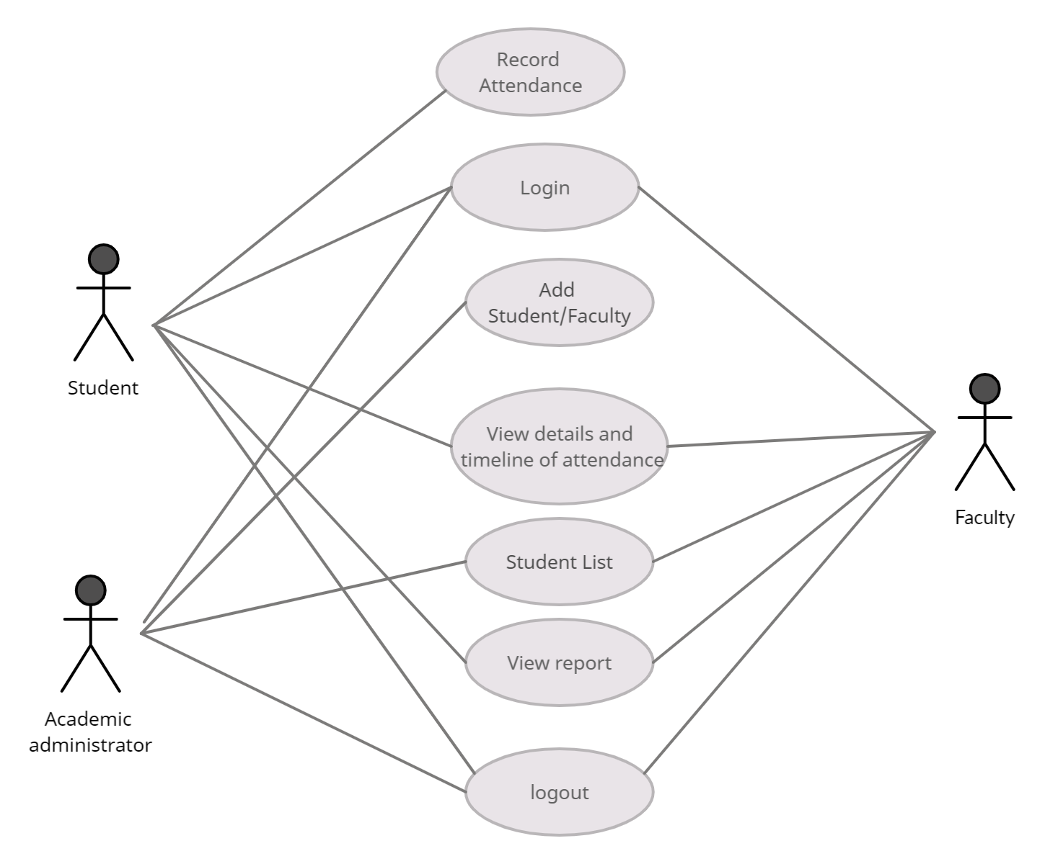
Use case Diagram
Why Should I Study this course?
Examples
BVRIT HYDERABAD College of Engineering for Women

Slide 5
System Requirements
Why Should I Study this course?
Environment | Specifications
Hardware | Processor: Intel Core i5
 | RAM: 4 GB
 | IOT fingerprint Scanner
Software | Eclipse IDE , MySQL
 | Operating System: Windows 10
 | Browser: Google Chrome, Mozilla Firefox
Examples
BVRIT HYDERABAD College of Engineering for Women

Slide 6
References
Why Should I Study this course?
[1] K. Christidis and M. Devetsikiotis, “Blockchains and Smart Contracts for the Internet of Things”, in Digital Object Identifier 10.1109/Access.2016.2566339 Volume 4, 2016.
[2] H. Watanabe, S. Fujimura, A. Nakadaira, Y. Miyazaki, A. Akutsu, and J.J. Kishigami, “Blockchain Contract: A Complete Consensus using Blockchain”, in IEEE International Conference on Consumer Electronics (ICCE), 2016.
[3] X. Xu, I. Weber, M. Staples, L. Zhu, J. Bosh, L. Bass, C. Pautassos, and P. Rimba, “A Taxonomy of Blockchain-Based Systems for Architecture Design”, in IEEE International Conference on Software Architecture, p243-252, 2017.
[4] Z. Zheng, S. Xie, H. Dai, X. Chen, and H. Wang, “An Overview of Blockchain Technology: Architecture, Consensus, and Future Trends:, IEEE 6th International Congress on Big Data, p. 557-564, 2017.
[5] M. Conoscenti, A.Vetro, and J.C. De Martin, “Blockchain for the Internet of Things: a Systematic Literature Review”, 978-1-5090-4320- 0/16, IEEE, 2016.
[6] J. Pereira, M.M. Tavalaei and H. Ozalp, “Blockchained-based platforms: decentralized infrasturctures and its boundary conditions”, Technological Forecasting & Social Change, pp. 94-102, 2019.
Examples
BVRIT HYDERABAD College of Engineering for Women

Slide 7
THANK YOU

